Slide 1
Yo fui de vacaciones en Chile.
SPA II Unit 4
Rhodes
Notes:
This is a presentational writing/speaking project for my level 2s. I gave them the first and last sentence of their travel diary and all the pictures in between. They will fill in the inside with the ACTUAL INFORMATION about Chile. They have to look up the specifics about the places and write 3 sentences per slide in the past. I will check their sentences for accuracy, give feedback, and when they’re done, they’ll narrate each slide and upload their version of the PowerPoint to my Google Drive.

Slide 2
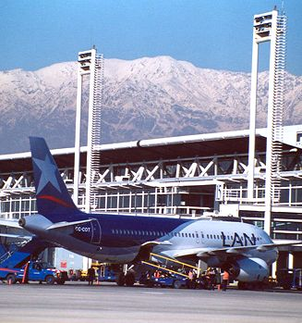
Yo fui a Chile el verano pasado…

Slide 4
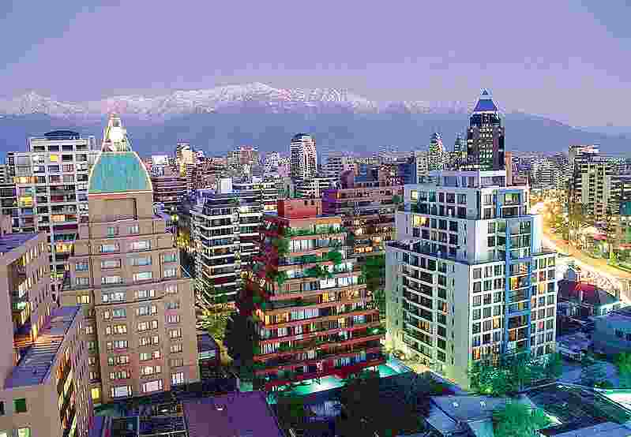

Slide 5
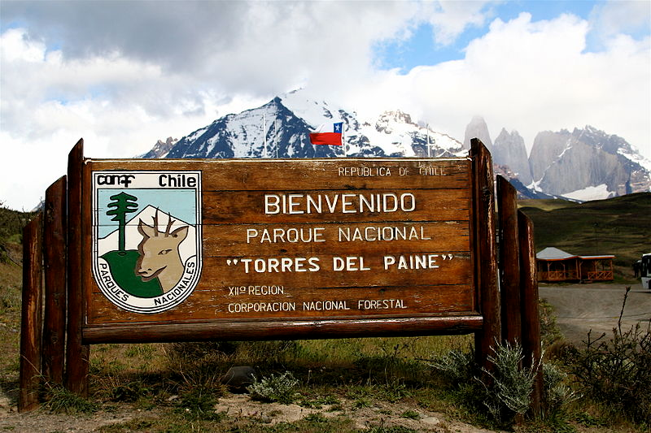

Slide 6
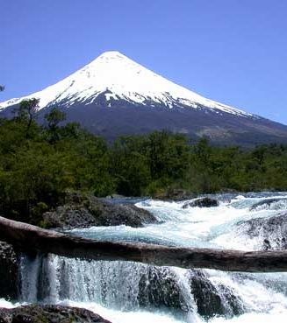

Slide 7
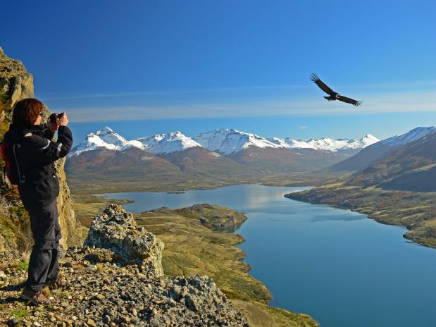

Slide 8
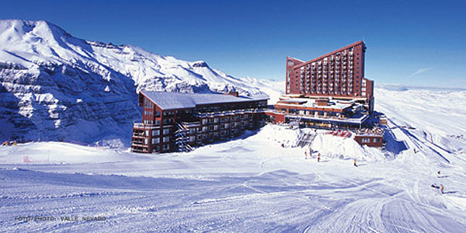

Slide 9
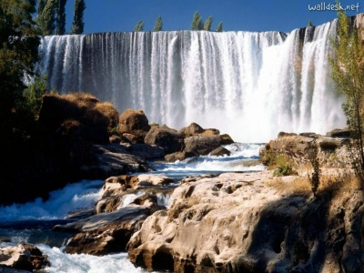

Slide 10
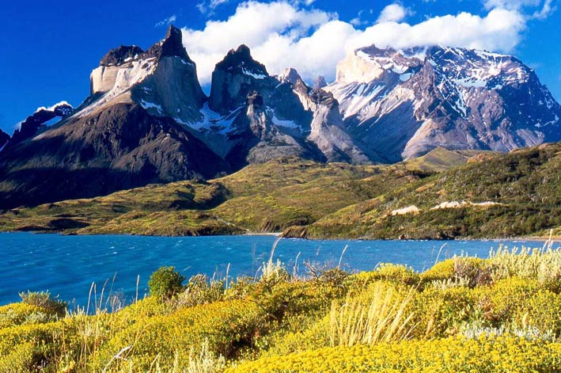

Slide 11
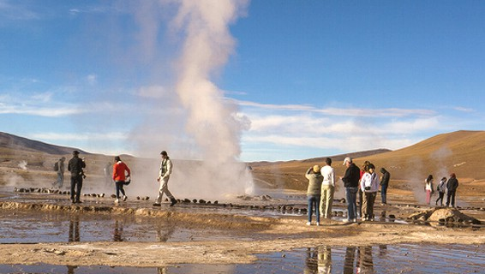

Slide 12
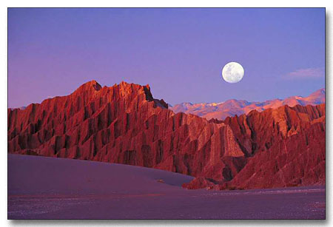

Slide 13
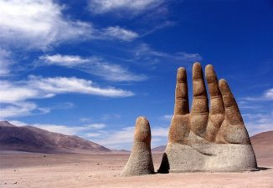

Slide 14
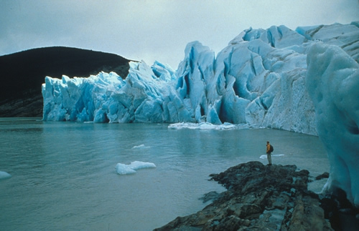

Slide 15
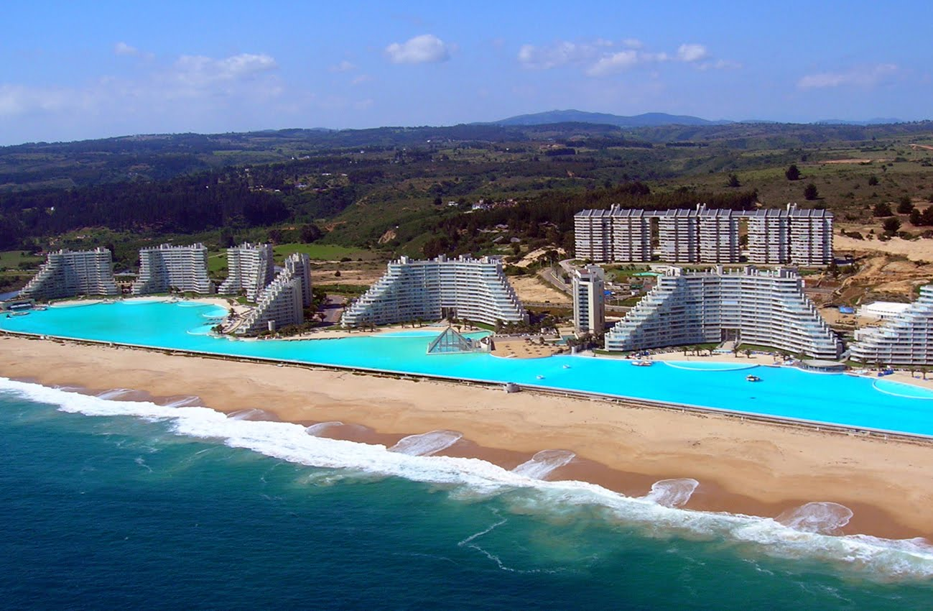

Slide 16
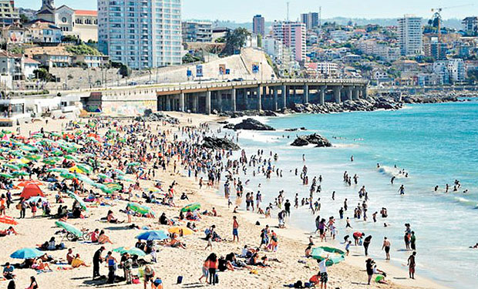

Slide 17
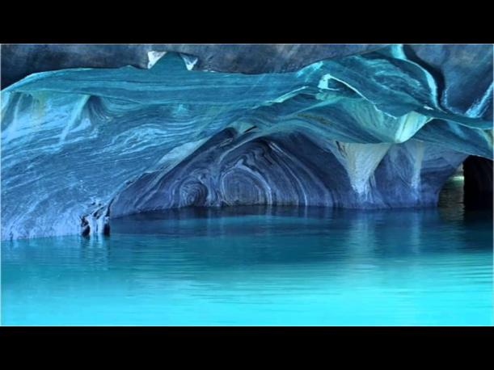

Slide 18
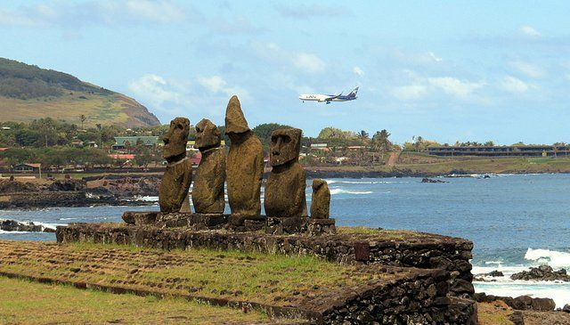

Slide 19
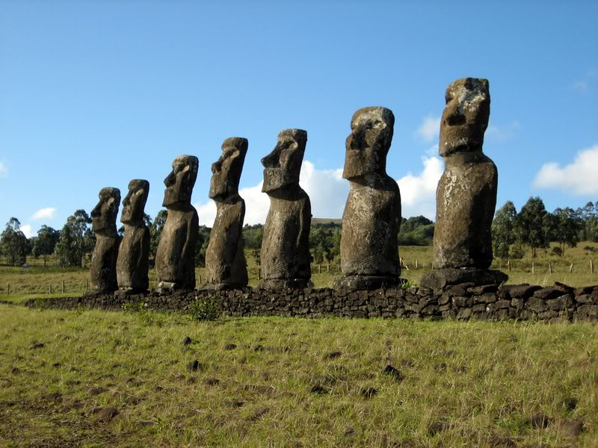

Slide 20
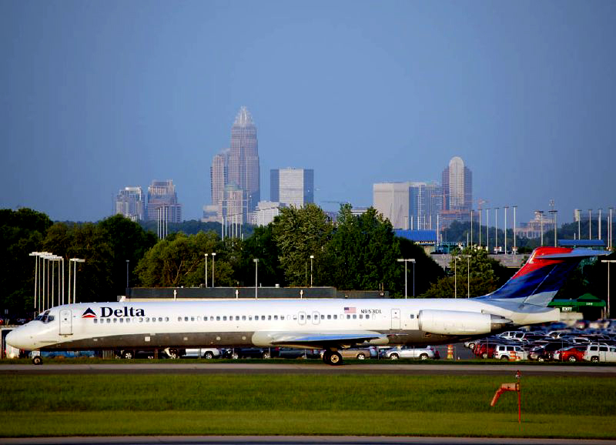
Yo salí de Chile y regresé a mi casa en Charlotte.

